Slide 1
Economics Project – 4 Srilankan Economy Developed or Developing
Group - 13

Slide 2
Group Members
Deep Parekh – 1401001
Jeet Parekh – 1401011
Akash Soni – 1401047
Kashish Shah – 1401048
Raj Shah – 1401050
Abhishek Chaudhary-1401059
Deval Shah – 1401060
Maharshi Bhavsar – 1401061
Malav Vora - 1401062

Slide 3
Outline
Resources
Overview Of Srilankan Economy
GDP of Srilanka
Sectoral GDP growth
Inflation Study 1986-2016
Trade Statistics of Srilanka
International Trade
Imports
Exports
Top Imported And Exported Goods
Top Import and Export Partners
Balance of Trade
Overview of Monetary and Fiscal Policies of Srilanka
Foreign Direct Investment
Recent financial market affairs in Srilanka
Unemployment Trends
Poverty trends
Poverty Alleviation Strategies
Conclusion

Slide 4
Resources
http://www.cbsl.gov.lk/htm/english/04_mp/m_2.html#3
http://atlas.media.mit.edu/en/profile/country/lka/#Trade_Balance
http://www.tradingeconomics.com/sri-lanka/exports.
http://www.cbsl.gov.lk/htm/english/05_fss/f_1.html
http://blogs.wsj.com/indiarealtime/2016/01/09/george-soros-says-sri-lanka-is-exception-to-decline-of-financial-markets/
http://www.cbsl.gov.lk/pics_n_docs/10_pub/_docs/statistics/other/Socio_Econ_Data_2014_e.pdf
https://www.colombotelegraph.com/index.php/sri-lankan-economy-perspectives-on-growth-and-development/
http://www.tradingeconomics.com/sri-lanka/foreign-direct-investment
http://www.tradingeconomics.com/sri-lanka/indicators
http://www.cbsl.gov.lk/htm/english/08_stat/s_4.html

Slide 5
Overview of Sri Lanka’s Economy
Sri Lanka’s growth was marginally lower in 2015 while the current account deficit improved slightly and inflation moderated.
Meanwhile, the budget deficit widened and foreign exchange reserves dropped sharply.
Economic expansion has markedly slowed in the past 3 years from the rapid pace of the post-conflict economic boom.
Selected economic indicators (%) – Sri Lanka | 2015 | 2016 Forecast | 2017 Forecast
GDP Growth | 4.8 | 5.3 | 5.8
Inflation | 3.8 | 4.5 | 5.0
Current Account Balance (share of GDP) | -2.0 | -2.0 | -1.8

Slide 6
Overview of Sri Lanka’s Economy
Provisional estimates place growth at 4.8% in 2015, marginally lower than the 4.9% expansion a year earlier.
On the supply side, 5.3% expansion in the large service sector was the main driver of growth as the contribution from industry declined.
Weak global demand and uncertainty over policy will continue to hold down economic performance in 2016.
Weak demand and low prices for Sri Lanka’s major exports will constrain economic growth and exert pressure on the balance of payments, though somewhat lower oil prices projected for 2016 will alleviate this pressure, albeit less than in 2015.
Continued concern over fiscal consolidation will hinder foreign investment and other capital inflows.

Slide 7
Overview of Sri Lanka’s Economy
Notably, In February 2016 Fitch Ratings downgraded Sri Lanka to B+ from BB– with a negative outlook because of rising refinancing risk and weaker public finances.
Private investment can recover to drive economic growth in 2016, assuming that the revised budget is approved in mid-2016, the national development strategy is finalized, and agreement is reached with the International Monetary Fund on possible support.
In this scenario, economic growth is projected to pick up to 5.3% in 2016 and further to 5.8% in 2017 as the global environment improves.

Slide 8
GDP of Sri Lanka
According to data of World Bank,
GDP (PPP) of Sri Lanka in 2015:
$217.4 billion
7.4% growth
7.5% 5-year compound annual growth
$10,372 per capita income
GDP of Sri Lanka began to increase rapidly after the end of the Sri Lankan Civil War in 2002

Slide 9
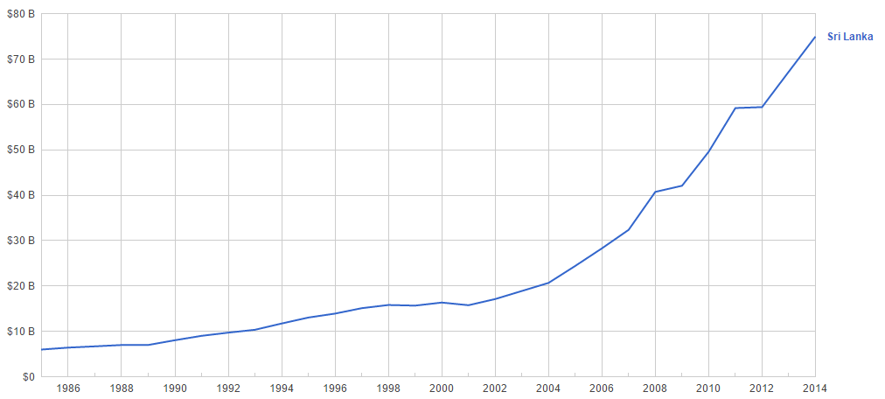
GDP of Sri Lanka
It is clear from the graph, after 2002, GDP of Sri Lanka started increasing rapidly

Slide 10
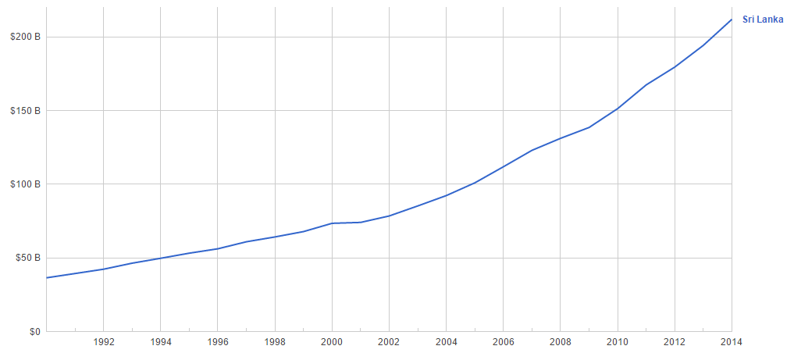
Gross National Income in PPP Dollars
It is clear from the graph, after 2002, GDP of Sri Lanka started increasing rapidly

Slide 11
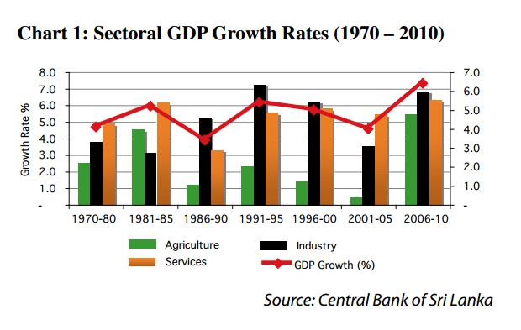

Slide 12
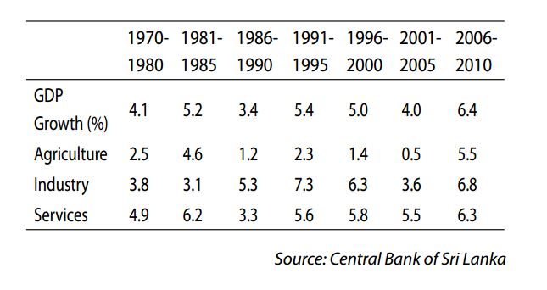
Sectoral GDP Growth Rates (1970 – 2010

Slide 13
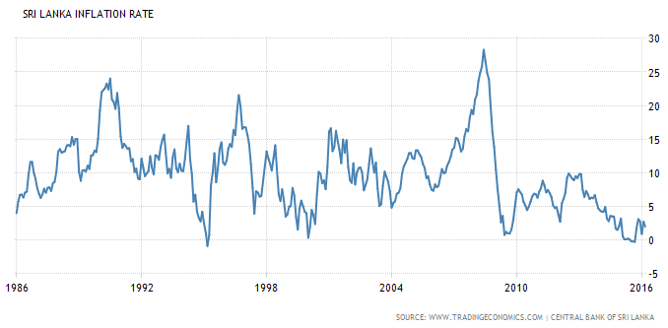
Inflation in Sri Lanka (1986-2016)
The inflation rate in Sri Lanka was recorded at 2 % in March of 2016.
Inflation Rate in Sri Lanka averaged 9.83 percent from 1986 until 2016,
Reaching an all-time high of 28.31 percent in June of 2008,
A record low of -0.89 percent in March of 1995.

Slide 14
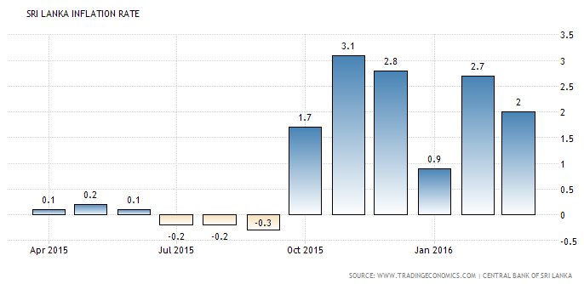
Inflation in Sri Lanka (2015-2016)

Slide 15
Trade Statistics of Sri Lanka
Total Exports (2015) | $11,295,485,896
Total Imports (2015) | $19,244,461,189
Trade Balance (2015) | -$7,948,975,293
Exports of goods and services (% of GDP) | 22.33%
Imports of goods and services (% of GDP) | 30.88%

Slide 16
International Trade
Sri Lanka is the 92nd largest export economy in the world and the 83rd most complex economy according to the Economic Complexity Index (ECI).
In 2013, Sri Lanka
exported $10.4B
imported $18.4B,
resulting in a negative trade balance of $7.95B.

Slide 17
Imports
In 2013 Sri Lanka imported $18.4B, making it the 83rd largest importer in the world.
During the last five years the imports of Sri Lanka have increased at an annualized rate of 5.3%, from $14.2B in 2008 to $18.4B in 2013.
The most recent imports are led by Refined Petroleum which represent 12.8% of the total imports of Sri Lanka, followed by Crude Petroleum, which account for 6.63%.
Sri Lanka imports petroleum, textile fabrics, foodstuffs and machinery and transportation equipment.
Main import partners are India, China, Iran and Singapore.
Imports in Sri Lanka averaged 1091.36 USD Million from 2001 until 2015, reaching an all time high of 1986.40 USD Million in November of 2011 and a record low of 408 USD Million in February of 2002.
Imports in Sri Lanka is reported by the Central Bank of Sri Lanka.

Slide 18
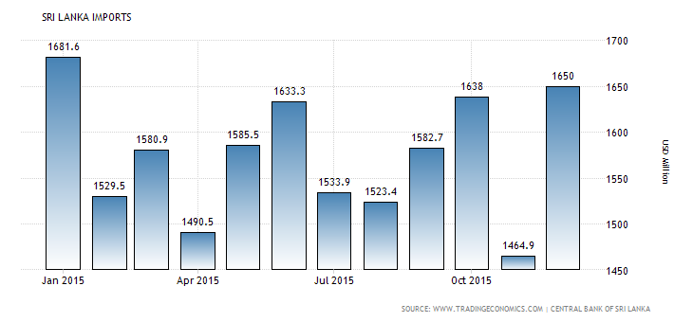
Srilankan Import Statistics 2015
Year

Slide 19
Exports
In 2013 Sri Lanka exported $10.4B, making it the 92nd largest exporter in the world. During the last five years the exports of Sri Lanka have increased at an annualized rate of 3%, from $8.98B in 2008 to $10.4B in 2013. The most recent exports are led by Tea which represent 13.3% of the total exports of Sri Lanka, followed by Non-Knit Women's Suits, which account for 5.52%.
The top exports of Sri Lanka are
Tea ($1.38B),
Non-Knit Women's Suits($574M),
Other Women's Undergarments ($518M),
Non-Knit Men's Suits($446M) and Knit Women's Suits ($436M), using the 1992 revision of the HS (Harmonized System) classification.

Slide 20
Exports
The top export destinations of Sri Lanka are the United States ($2.4B),the United Kingdom ($1.12B), Germany ($590M), India ($515M) and Italy($461M). The top import origins are India ($4.11B), China ($2.83B),Singapore ($1.72B), the United Arab Emirates ($1.12B) and Oman($713M).
Exports in Sri Lanka decreased to 817 USD Million in December from 835.20 USD Million in November of 2015.
Exports in Sri Lanka averaged 692.15 USD Million from 2003 until 2015, reaching an all time high of 1069.90 USD Million in March of 2014 and a record low of 304.80 USD Million in April of 2003.
Exports in Sri Lanka is reported by the Central Bank of Sri Lanka.

Slide 21
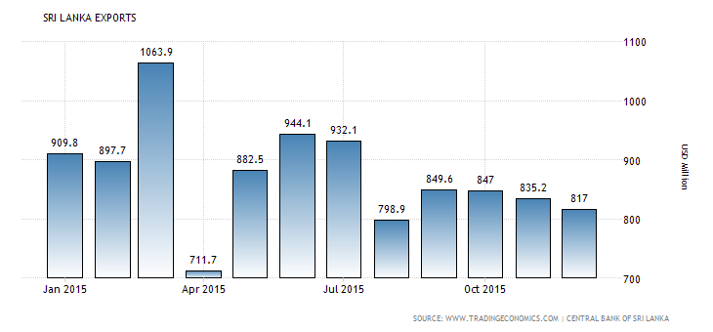
In USD
year

Slide 22
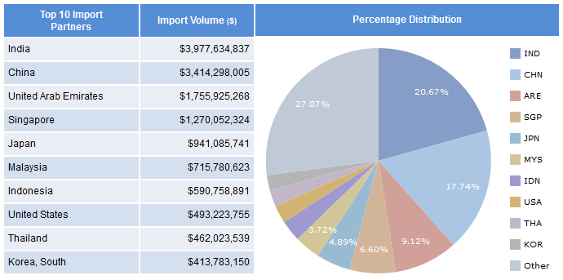
Import Partners
INDIA is largest importer of Srilanka.
About 27.7% of total import of Srilanka comes from India.
Following India, China and United Arab Emirates are leading importer partners of Srilanka

Slide 23
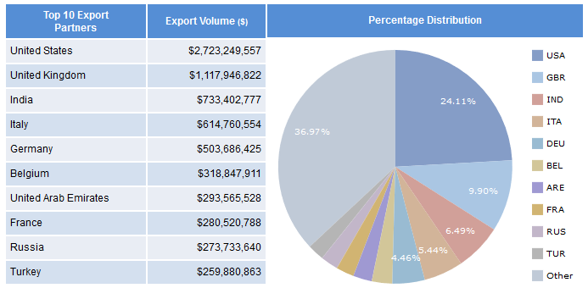
Top Export Trade Partners of Sri Lanka
United States is largest importer for Srilankan goods and services.
About 36.7% of total export of Srilanka is solely attained by united states.
Following US, UK and India are leading export partners for Srilanka.

Slide 24
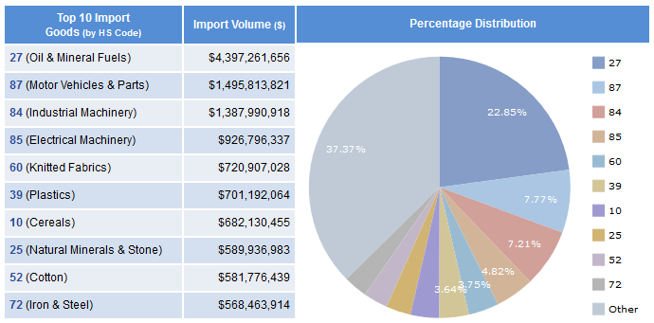
Top Imported Goods
Oil and Mineral Fuels are largely imported from other countries.
About 37.7% of total imported goods is oil and mineral fuels.
Machinery and motor vehicle parts are also imported in huge amount

Slide 25
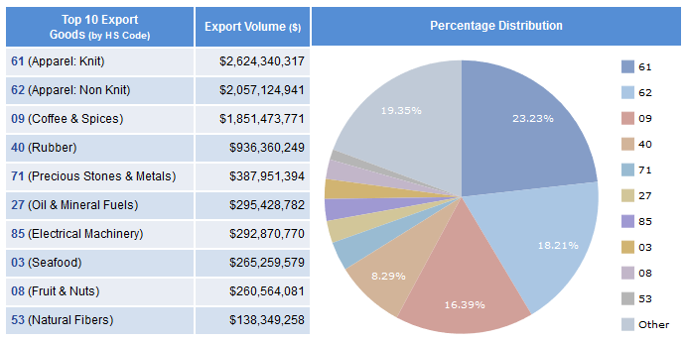
Top Exported Goods
The highest exported good of Srilanka is knit.
About 23.3% of total goods exported is knit.
Also non-knit apparel ,coffee & spices etc. .are largely exported from Srilanka every year.

Slide 26
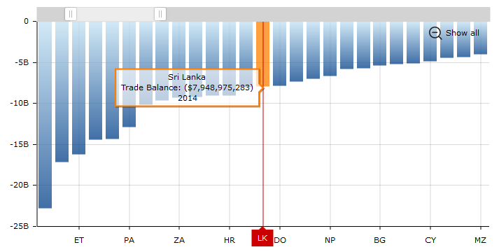
Comparison of Trade Balance of Different Countries
The net trade balance of Srilanka is negative $7,948,975,293.
The reason for that is srilanka is developing economy and so amount of imports tends to be more than amount of exports.

Slide 27
Relations between Srilanka and India
Sri Lanka has long been a priority destination for direct investment from India.
Sri Lanka is India’s second largest trading partner in SAARC(South Asian Association for Regional Cooperation).
India in turn is Sri Lanka’s largest trade partner globally. Trade between the two countries grew particularly rapidly after the entry into force of the India-Sri Lanka Free Trade Agreement in March 2000.
According to Sri Lankan Customs, bilateral trade in 2014 amounted to US $ 4.6 billion, achieving a growth of 23.37% compared to 2013.
Exports from India to Sri Lanka in 2014 were US$ 3977 million, while exports from Sri Lanka to India were US $ 625 million.
India is among the top four investors in Sri Lanka with cumulative investments of over US$ 1 billion since 2003.
The investments are in diverse areas including petroleum retail, IT, financial services, real estate, telecommunication, hospitality & tourism, banking and food processing (tea & fruit juices), metal industries, tires, cement, glass manufacturing, and infrastructure development (railway, power, water supply).

Slide 28
Many new investments from Indian companies are in the pipeline or under implementation out of which few are given below :
Notable among them are proposals of Shree Renuka Sugar to set up a sugar refining plant at Hambantota (US $ 220 million), South City.
Kolkata for real estate development in Colombo (US $ 400 million).
Tata Housing Slave Island Development project along with Urban Development Authority of Sri Lanka (US $ 430 million), ‘Colombo One’ project of ITC Ltd. (ITC has committed an investment of US$ 300 million, augmenting the earlier committed US 140 million).
Dabur has already set up a fruit juice manufacturing plant (US$ 17 million) in May 2013.
On the other hand, the last few years have also witnessed an increasing trend of Sri Lankan investments into India.
Significant examples include
Brandix (about US$ 1 billion to set up a garment city in Vishakapatnam),
MAS holdings, John Keels, Hayleys, and Aitken Spence (Hotels), apart from other investments in the freight servicing and logistics sector.

Slide 29
Agriculture Sector
Agriculture is a pillar of Sri Lanka’s economy, accounting for 10.1% of GDP.
However, 2014 was a difficult year for many producers, bringing a raft of challenges including adverse weather conditions and competition from imports.
Indicators suggest that agriculture continued to underperform against other sectors in the early part of 2015.
A central bank report issued in early May showed industrial exports in February growing 7.1% year-on-year (y-o-y), while farm produce exports expanded by just 0.8%.
Higher spending on consumer goods, including food products such as rice, was cited by the bank as a key reason for the increase in Sri Lanka’s import bill and the widening of the trade deficit by 10.4% y-o-y in February to $638m.

Slide 30
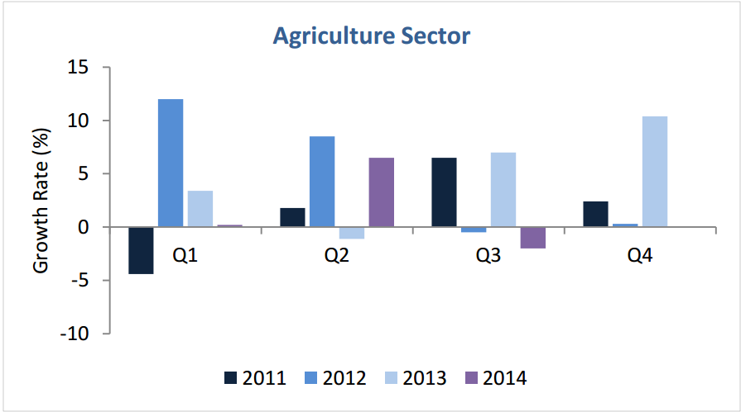
Agriculture is Srilanka’s comprises highest GDP share of 10.1% .
For past five years the growth rate in agro sector is fluctuating due to lack of advanced resources in agriculture resulting more labor converting into less output

Slide 31
MONETARY POLICY FRAMEWORK OF SRI LANKA
At present monetary management in Sri Lanka is based on a monetary targeting framework.
In this framework, the final target, price stability, is to be achieved by influencing change in broad money supply which is linked to reserve money through a multiplier.
Reserve money is the operating target of monetary policy. The monetary targeting framework is operated through a monetary program
The monetary program is prepared by the Central Bank taking into account economic factors such as the expected fiscal and balance of payments developments, economic growth, desired levels of growth in credit and inflation.
Based on these factors, the monetary program sets out the desired path for monetary growth and determines the path of quarterly reserve money targets necessary to achieve this monetary growth.

Slide 32
The public investment-led development drive is set to continue and underpin the economic recovery efforts, with public investment as a percentage of GDP set at 6.1% in 2013.
In a departure from recent years when foreign financing comprised a large chunk of the deficit financing requirement, the Budget 2013 has opted to rely heavily on domestic borrowing to bridge the deficit.
Of the relatively high domestic financing component of 4.8% of GDP, 3.3% is to be raised from non-bank borrowing.
With the government tapping domestic sources for the bulk of its deficit financing requirement, a pertinent question is whether Sri Lanka’s private sector, starved of funding in 2012 through the imposition of a credit ceiling on commercial bank lending, will be crowded-out further in 2013 from undertaking investment.
Indeed, a related issue is the extent to which Sri Lanka is making room for private investment to step-in, and relieve the fiscal burden of driving the country’s investment growth in the current post-conflict phase of development.

Slide 33
Fiscal Policy In Srilanka
Sri Lanka stands at important crossroads as it makes a decisive transition into a middle-income economy. With GDP growth targeted at 7.5 – 8% over the medium term, the need for effective fiscal consolidation cannot be overemphasized.
In this light, recent budgets have shown concentrated efforts to address fiscal management by pursuing the commendable strategy of cutting down on recurrent expenditure while maintaining higher capital expenditure.
Contracting current expenditure from 18.2% of GDP in 2009 to an estimated 14.1% of GDP in 2013 and shrinking the budget deficit from 9.9% of GDP in 2009 to an estimated 5.8 % of GDP in 2013 have been successful outcomes of recent fiscal consolidation efforts

Slide 34
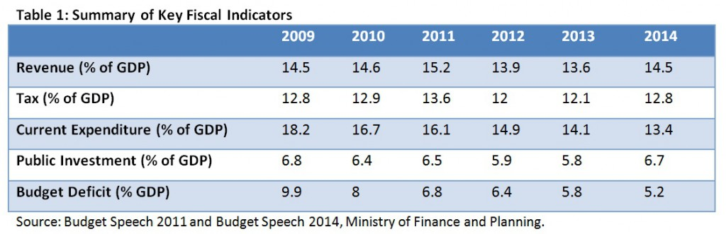
Study of Fiscal Policy Report 2014 - Srilanka
It is clear from Budget 2014 that Sri Lanka is has taking noteworthy steps in improving fiscal consolidation.
However, the quality of fiscal consolidation still remains to be improved in the context of increased reliance on foreign borrowing in the face of a weakening export earnings position and sluggish revenue growth.
However, the country seems to be steering in the right direction with determined efforts to cut back on current expenditure while raising capital expenditure.
Nevertheless, Sri Lanka must make more concentrated efforts to promote its export sector, as building a strong reserve base through increased export earnings remains the linchpin of the country’s overall fiscal consolidation process.

Slide 35
FDI (Foreign Direct Investments)
During 2014, Sri Lanka attracted Foreign Direct Investments amounting to US $ 1,685 million - a 21% increase from 2013, but below the US $ 2 billion target set by the government.
Sri Lanka consistently failed to reach FDI targets in recent years although the overall FDI trend remains positive.
FDI, as a percentage of gross domestic product (GDP) improved to 2.2 percent in 2014 compared to 2.0 percent in 2013.
Foreign Direct Investment in Sri Lanka increased by 153 USD Million in the third quarter of 2015. Foreign Direct Investment in Sri Lanka averaged 127.31 USD Million from 2001 until 2015, reaching an all time high of 386 USD Million in the fourth quarter of 2013 and a record low of 20 USD Million in the second quarter of 2001.
Foreign Direct Investment in Sri Lanka is reported by the Central Bank of Sri Lanka.

Slide 36
Out of the US $ 1,685 million FDI recorded in 2014, 33 percent or US $ 564 million represents foreign capital inflow to the economy. This includes (net) capital inflows in the form of equity and debt from promoters of various ventures/projects.
Reinvestment of retained earnings (internally generated capital) has accounted for a further 22 percent of FDI or US $ 381 million.
Increase in reinvestments by existing firms is a positive trend.
Borrowings or bank loans have accounted for a significant 44 percent of FDI in 2014, compared to 34 percent in 2013.
Bank borrowings included in FDI have increased by 55 percent from last year to reach US $ 740 million in 2014.
A large share of bank borrowing appears to be loans given by international banking units of local commercial banks. Also, increase in borrowings and reinvestments represent mostly expansions by the existing businesses and do not represent new business start-ups.

Slide 37
Decline Of Financial Markets
Hungarian-born US magnate and philanthropist George Soros attends an economic forum in Colombo on Jan. 7, 2016.
He told the audience at the event in Colombo where attendees included President Maithripala Sirisena and Prime Minister Ranil Wickremesinghe that “Sri Lanka’s new government is trying to woo investors after a year in office.
Sri Lanka Is Exception to Decline of Financial Markets. You have to lower your expectations…because this is only the beginning of the decline of financial markets and this is just the beginning of Sri Lanka being an exception .”

Slide 38
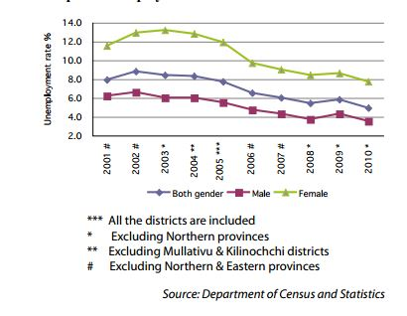
Unemployment trends
A sustained high level of growth is the main factor which helps to reduce unemployment as has been seen in Sri Lanka over the past decade.
Over these years, while economic growth has increased from 6.0 per cent in 2000 to 8.0 per cent in 2010, so has overall unemployment fallen from 7.9 per cent to 4.9 per cent in 2010.

Slide 39
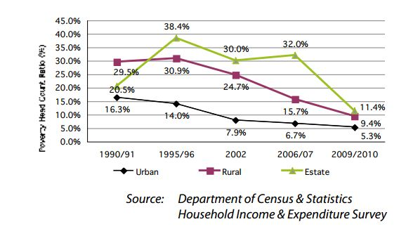
Poverty Head Count Ratio by Sector - Survey periods 1990/91 – 2009/10
As a country, the poverty shortfall of Sri Lanka has declined from approximately Rs. 1.3 billion in 2006/07 to Rs. 1 billion per month in 2009/10.
This is commendable considering inflation, population growth and increased survey coverage when compared to 2006/07.
At the same time, this reflects of the decline in the number of people living below the poverty line from 2.8 million in 2006/07 to 1.8 million in 2009/10.

Slide 40
Poverty Alleviation Strategies
Since independence, successive governments of Sri Lanka have been committed to the upliftment of the socio-economic wellbeing of people.
Poverty alleviation has been an integral part of the government’s consistent dedication towards rapid social development and reducing associated social inequalities.
The macroeconomic environment which was conducive to achieve high rates of economic growth in recent times especially during the past five years has helped bring incidence of poverty significantly down.
High economic growth which is regionally balanced and inclusive in nature was one of the main reasons to achieve a single digit level of poverty in 2010.
Poverty alleviation programmes which come under the purview of the Department of Commissioner General of Samurdhi include: Samurdhi subsidy programmed, Nutrition allowance programme, Dry rations for Internally Displaced Persons, Samurdhi Social Security Programme, Kerosene subsidy stamp programme to name a few.
Poverty alleviation programmes have gone beyond providing financialand commodity assistance to community development programmes, income generation programmes and evencapacity building programmes so as to equip those in poverty with skills which induce them to look for more productive means of livelihood.

Slide 41
It is obvious that incidence of poverty has come down significantly in Sri Lanka benefitting from considerable economic progress took place during last few years in the country.
Simultaneously various policy interventions made throughout the last few decades to eradicate poverty also has helped in achieving lower levels of poverty. However, it should be noted that identification of disparities in poverty, among different geographical locations, is needed.
These have to be then assessed through proper poverty mapping exercise to improve targeting of poverty alleviation schemes.
Though, public policies implemented in Sri Lanka for several decades have delivered abundant results, halving country’s poverty and helping the integration of the country economically and allowing access to public services in all the provinces, in Sri Lanka’s journey towards a middle income country it has to focus more on socio economic policies which strive to improve living standards of people across provinces.

Slide 42
Conclusion
From analyzing the above statistics , we can say Srilanka is developing country and not developed because economy is growing and will require many years to a point of stable economy.
Srilanka has been fastest growing economy of Asia for past five years.
Also the inflation rate in Srilanka is very low as compared to other developing nations.
After civil war 2002 , Srilankan economy is boosted to a great extent.
The BOP deficit is still high but is gradually decreasing every year which is a good sign for economy.

Slide 43

END

